Slide 1
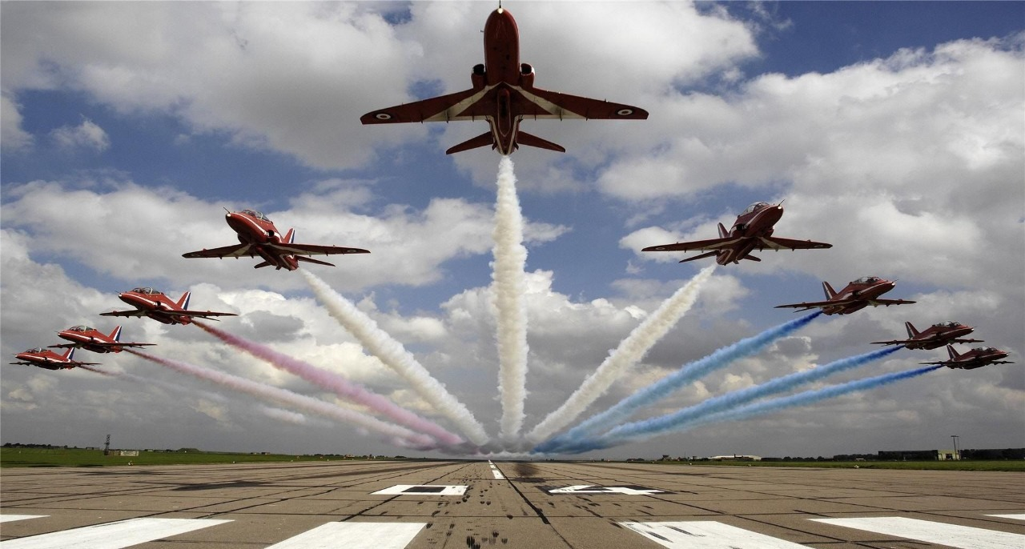

Slide 2

Military Sector
Group – 4
YOMESH YADAV - 19IM30024
RUPESH GARG - 19IM30019
PRERNA MALAKAR – 19IM30017
VADTHYA SANJAY KUMAR-19IM30022
UTSAV KUMAR PATEL - 19IM30021
PRASHANT JANGID 19IM30016
RISHI RATAN PATHAK - 19IM30018

Slide 3

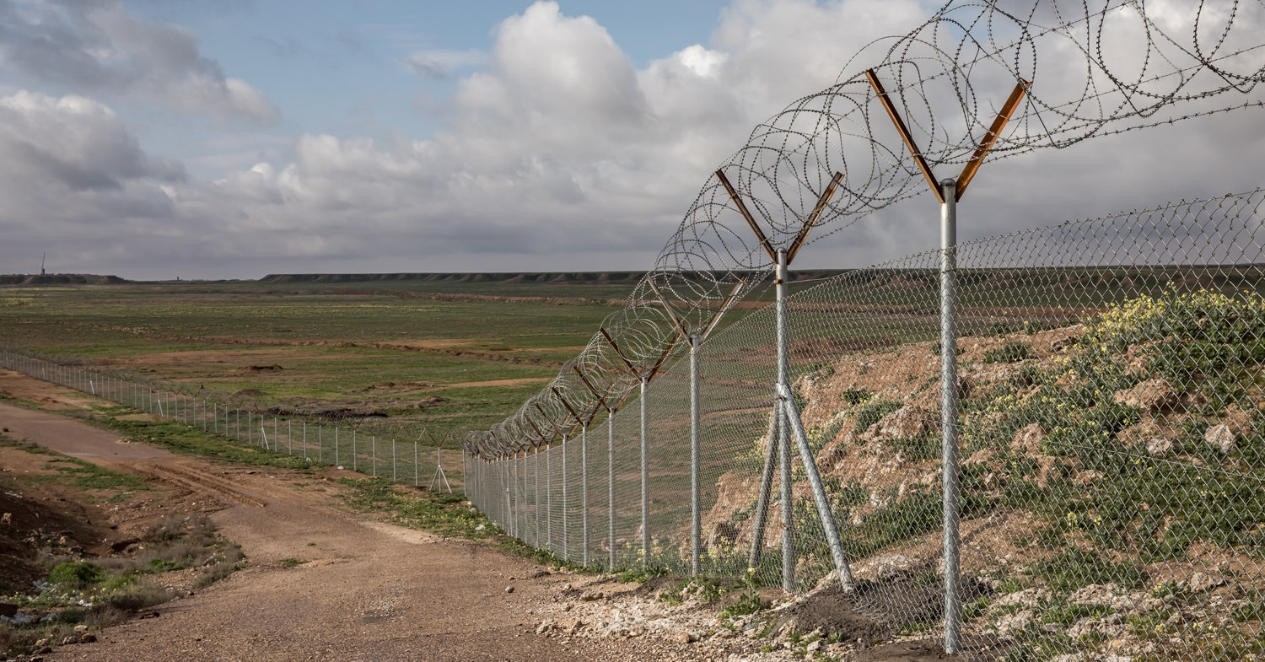
Problem Statement:
Ever wondered how terrorist enter into our border areas ?
So in general terrorist either enter through bypassing the fence or by an under ground tunnel so today we are going to present the solution to one of this problem .

Slide 4
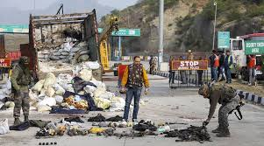
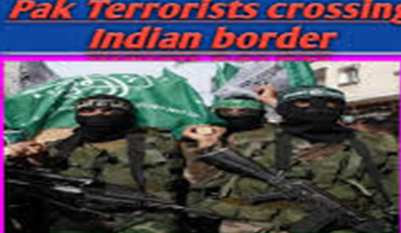
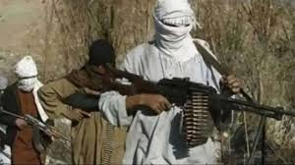
Terrorists entering Indian Border
Nagrota Terror Attack
Terrorists near Indian Border

Slide 5
Solution approach
Chip method will be introduced to differentiate between Indian Soldiers and enemies.
An ultrasonic sensor will be used for detecting objects far away and mapping them on a display. It will basically sense the presence of any human being or animals around the camp by emitting ultrasonic sound waves, and converting the reflected sound into an electrical signal.
Drones will be of great use here. Whenever the sensor will sense the presence of any living thing, drones will be sent to that exact location. It will use face recognition technology to detect whether that person is a soldier or an enemy. We will set up cameras in the camp, which will catch up on the images and send them to the database, counting the humans in the area. If it is an animal, we can also be notified by the drones.
If the drones successfully recognize the face, they will send those details to the Indian army database for checking.
If the face matches with any Indian soldiers whose details are already present in The Indian database, they will not take any action. Still, the soldiers whose faces are detected will be contacted immediately to be confirmed. But as soon as it is detected that there is a one percent chance that the person does not belong to the army, a group of soldiers will be sent to that location, and then they can handle the rest of it.
But a question may arise here. What if the drones fail to recognize the face of the person at that given location?
During such cases, data will be sent to the database with a message "Unable to detect”. A team of soldiers will immediately be sent to that exact location (depending upon the number of suspects present there, which the drones will notify), and then the rest will be handled by them.

Slide 6
Screenshots of our 3-D Models presenting the solution approach in a pictorial way

Slide 7
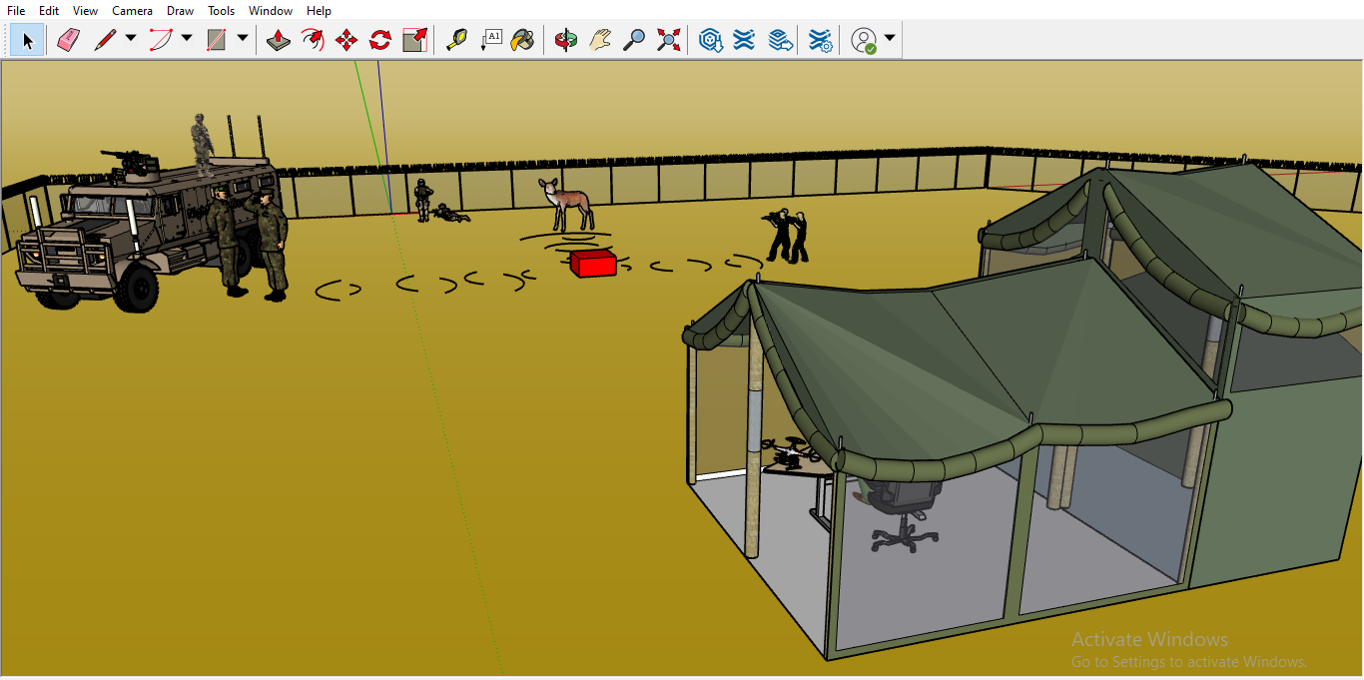

Slide 8
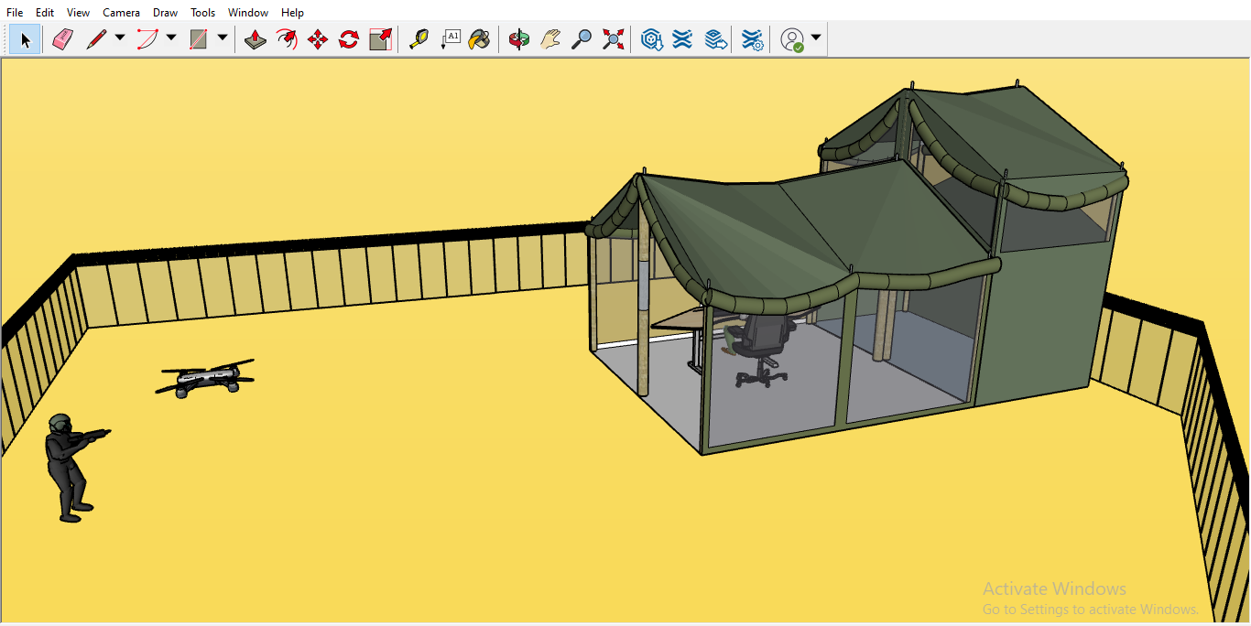

Slide 9
Use Of Chip Transmitter For Unique Identification Of Soldier

Slide 10
Chip method
Non implantable chip outside of body: Transmitter
Here, we can use this transmitter, which has a range greater than 5 km.
A transmitter is a set of equipment used to generate and transmit electromagnetic waves carrying messages or signals, especially those of radio or television.
Transmitter’s working:
The transmitter combines the information signal to be taken with the radio frequency signal, which generates the radio waves called the carrier signal. The transmitter's radio signal is applied to the antenna, which radiates the energy as radio waves.

Slide 11
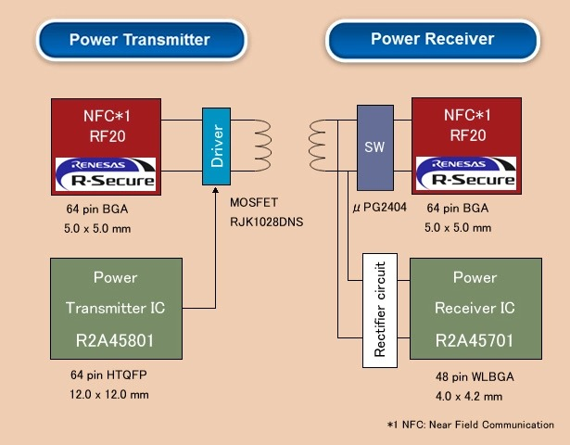
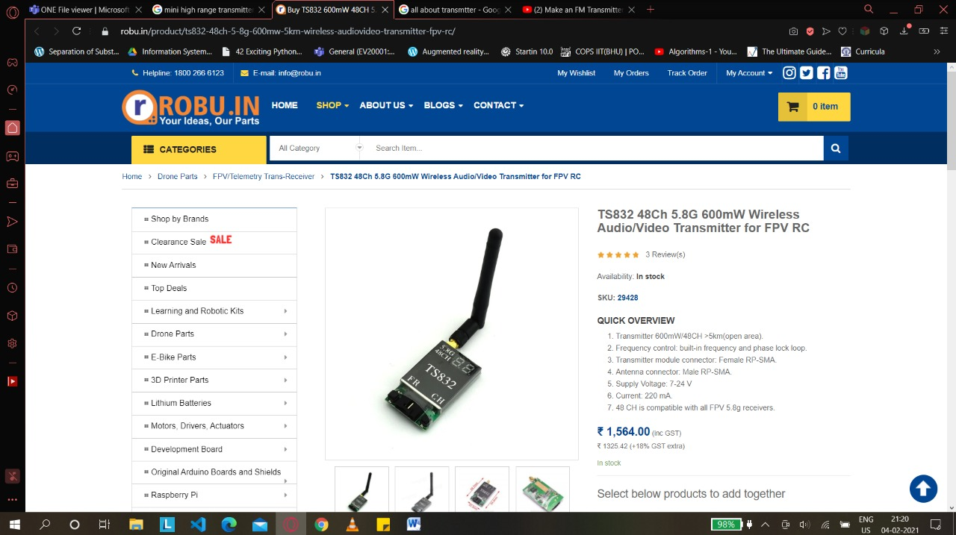
Wireless Chip Charging Technology
TS832 48Ch 5.8G 600 mW Wireless Audio/Video Transmitter for FPV RC

Slide 12
Transmitter working (contd..)
The oscillator creates the alternating current, a carrier wave, that the transmitter sends through the antenna.
The modulator adds information to the carrier wave. In the case of FM (frequency modulation), the modulator either slightly increases or decreases the carrier wave frequency.
The amplifier increases the power of the wave. More powerful amplifiers allow for a larger broadcast area.
Finally, the antenna converts the amplified signal to radio waves.
Right now, we have limited resources, but by using high-frequency military communication techniques, we can use them for our purpose.
We have an idea of a chip for now that can send signals up to 1 km, but with the help of military technology, we can improve it.
It is a high power, long-range, and easy to use RF wireless transceiver module. It works at the 433 MHz, comes with an external spring antenna, and can work in ranges up to 1000 meters (requires a stable power supply, low data rate, and low surrounding interference with the line of sight). This is one of the cheapest and easiest modules to do wireless communications.
We can use it to do bidirectional communication between devices. It has a standard Serial interface, which means you can directly interface this module to any microcontroller without the need for any external circuit.

Slide 13
Differentiation between Human And Animals Using Ultrasonic Sensor

Slide 14
Main Sensors used :
Ultrasonic
Acoustic
Seismic
Use of various sensors
Ultrasonic sensor :
To differentiate between animal and human
Seismic sensor :
To detect human or animal presence with the cadence of animal or people
Acoustic sensor :
To detect human or animal presence with voice detection
And at end we will combine all the 3 data results with a suitable algorithm

Slide 15
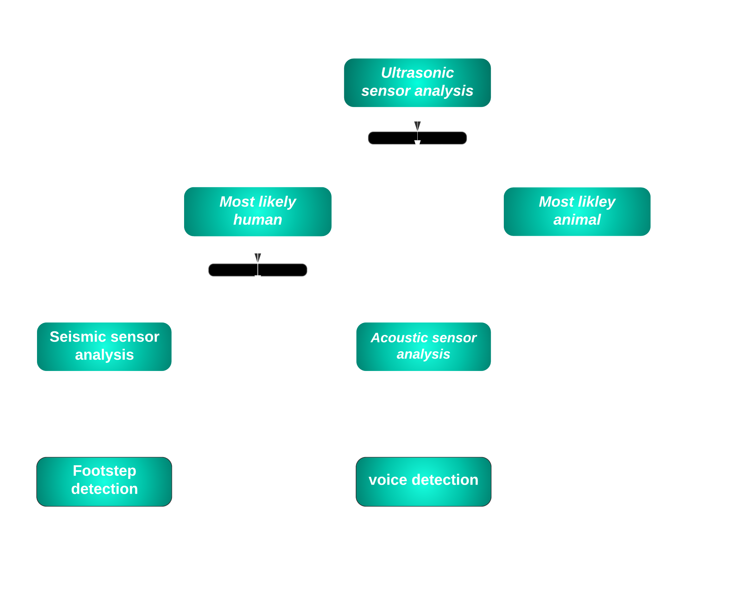

Slide 16
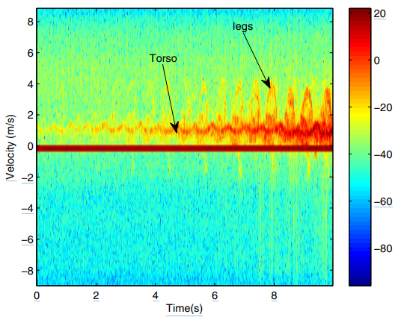
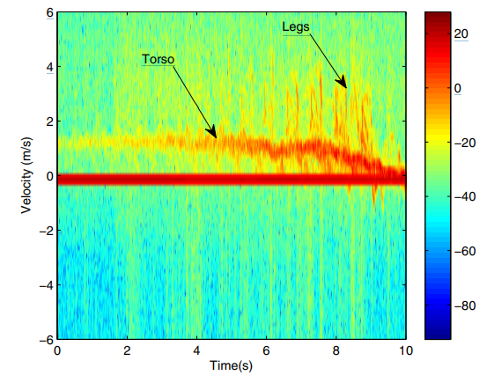
Ultrasonic sensor:
Use Of Ultrasonic Sensor In Our Project
We are going to use the energy(sound wave ) we receive from different objects let it be the doppler return which we get from the objects
From the experiment it is evident that the Doppler return of animals are different from that of humans which will then differ in energy which we get as a return, hence there we can use a support vector machine (a type of classification algorithm) to classify various energy in various energy bands
For example humans have a stronger Doppler returns from their torsos while animals have significantly weaker Doppler returns from their torsos
Human
Animal

Slide 17
Working of various sensors and use in our project
Acoustic sensor:
What we want to do from acoustic sensor ?
First of all acoustic sensor is used for detecting sound waves
Now as we know the sound from a human is modulated according to equation
s(t) = (Ac + Am sin ωmt ) cos ωct , although the frequency of human vary person to person but in general it lies between 200hz-800hz
In the equation given above we have 3 distinct frequency comoponents namely, fc, fc + fm and fc − fm. The spread of frequency is then 2fm around the carrier.
The algorithm which we are using is like we will be estimating the carrier signal frequency and the spread around it and if it passes above a certain threshold we will declare it as human

Slide 18
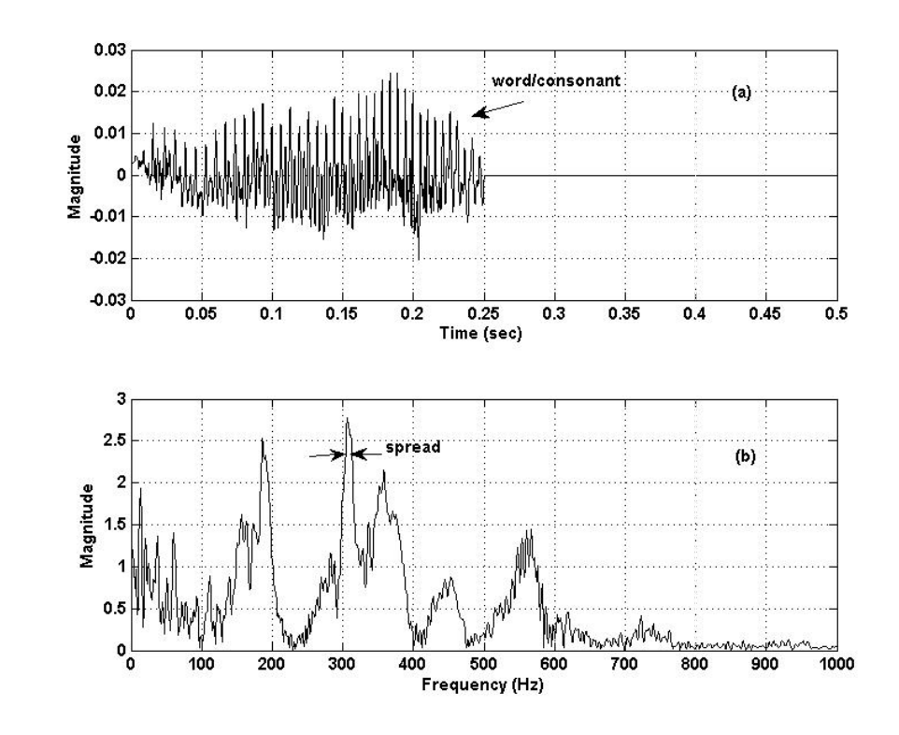
Acoustic Sensor Analysis Graph
Conversion of the acoustics sound graph from time to frequency domain via FFT

Slide 19
Seismic sensor :
What we are collecting from the seismic sensor ?
First of all a seismic sensor is an instrument used to measure the ground motion when it is shaken by a disturbance
It is estimated that the cadence of the humans walking lies between 1 to 2 Hz while the cadence of animals walking is around 2.5 - 3 Hz.
Even if many people are walking in a file (on a path), they tend to synchronize their steps with others and walk more or less at the same cadence. This gives a way to estimate the cadence and then classify it.
We use the magnitude of the signals along with the span of the signals above certain threshold(generally it the mean of absolute value of signatures) as the features to determine the presence of humans or animals.Then these features are used in a MVG(multivariate gaussian) classifier to classify the signatures

Slide 20
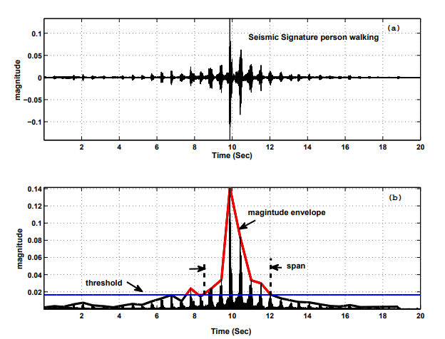
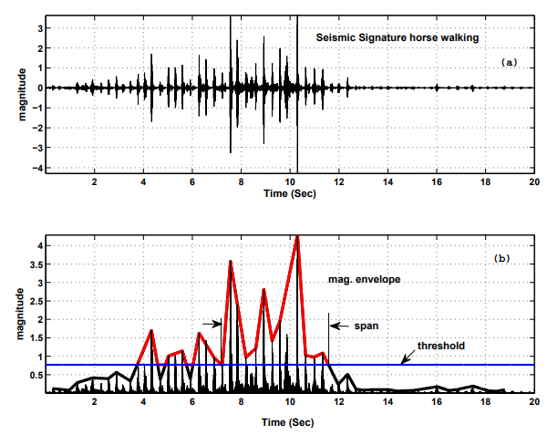
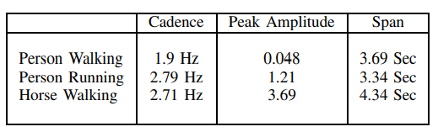
Illustrative Graph And Table For Seismic Sensor

Slide 21
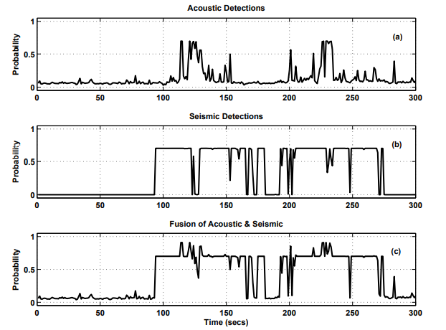
Final fusion of acoustic and seismic data for the use of ultrasonic sensor :
And at the end fusion of all the 3 sensor is done by Depster-Shafer algorithm, with all this if they classify the objects in 3 categories (human, animals and others) then the algorithm can predict correctly up to 95% and if they classify this into 2 categories( human and others) then they can predict correctly up to 98%

Slide 22
Use Of Drones For Final Verification

Slide 23
Drones
Drones are uncrewed aerial vehicles that are like aircraft without a human pilot on board.
Initially developed for the military and aerospace industries, drones have found their way into the mainstream because of the enhanced levels of safety and efficiency they bring. These robotic UAVs operate without a pilot on board and with different levels of autonomy. A drone’s autonomy level can range from remotely piloted (a human controls its movements) to advanced autonomy, which means that it relies on a system of sensors and LIDAR detectors to calculate its motion.
Parts of drones:
Drone Motor
Drone Propellers,
Drone Flight Controller (This is the brain of the drone.),
GPS Module,
Electronic Speed Controller (ESC),
Power Port Module,
Obstacle Avoidance Sensors,
3 Axis Gimbal,
Drone Camera, Drone Battery (we can use ndb in place of lithium polymer),

Slide 24
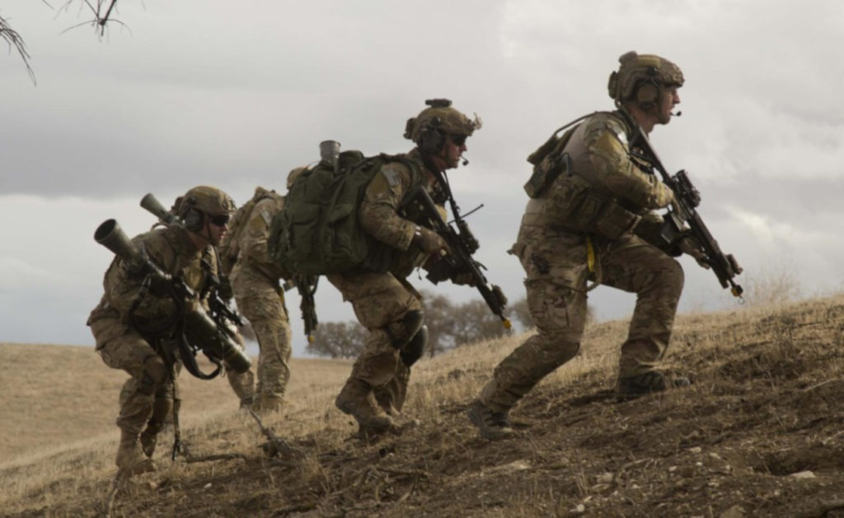
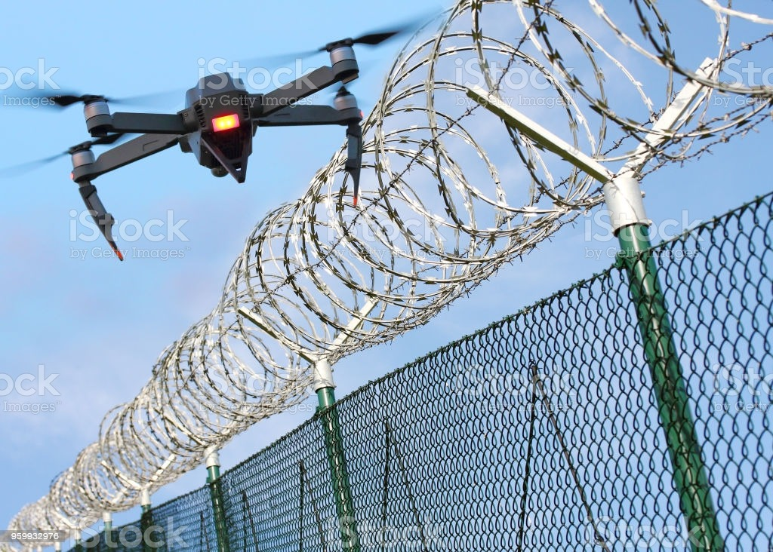
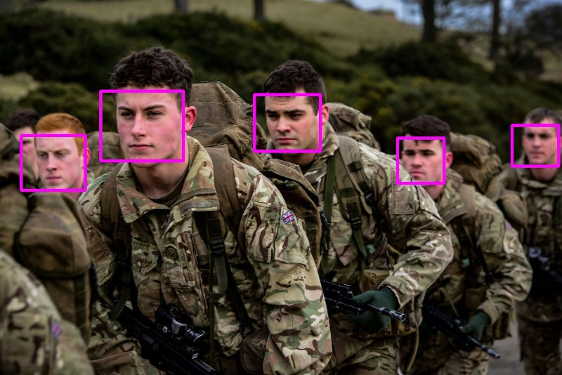
Terrorist Entering Border
Drone Flying Over the Border
Face Recognition Process

Slide 25
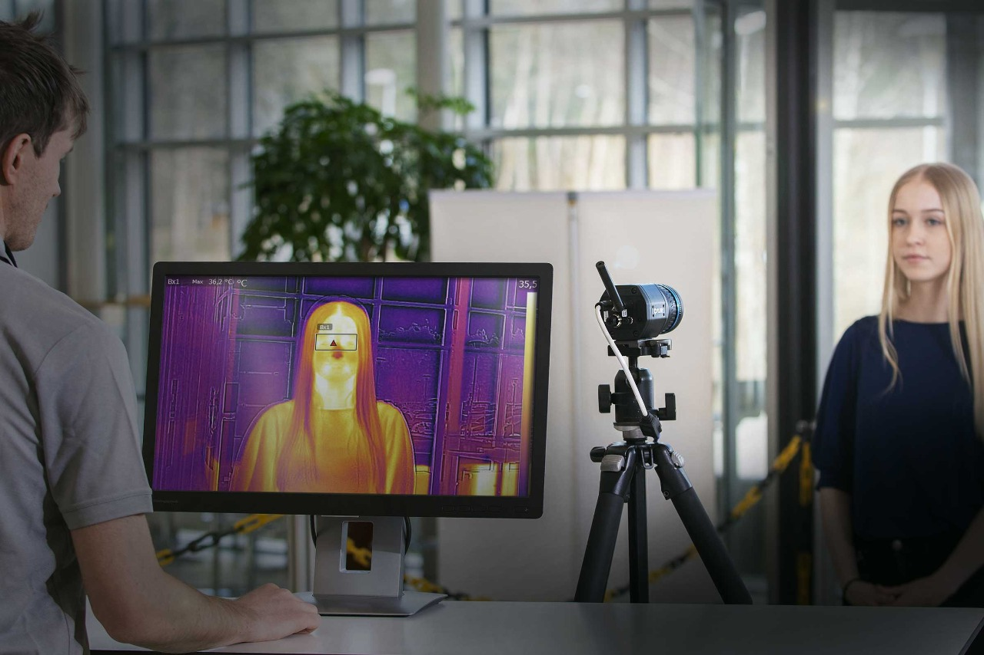
Capturing the face data to match when drone will use face recognition technique

Slide 26
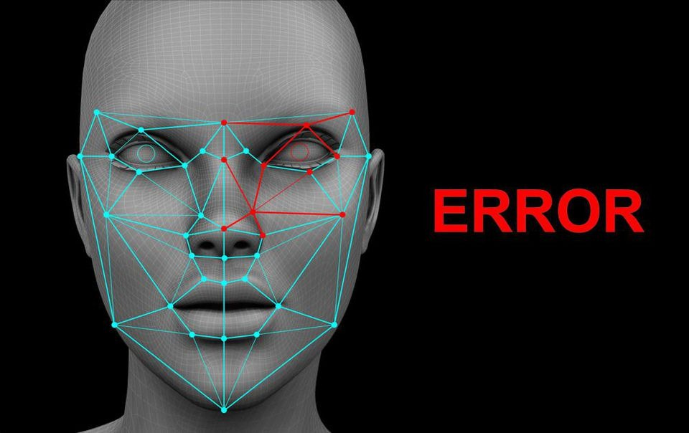
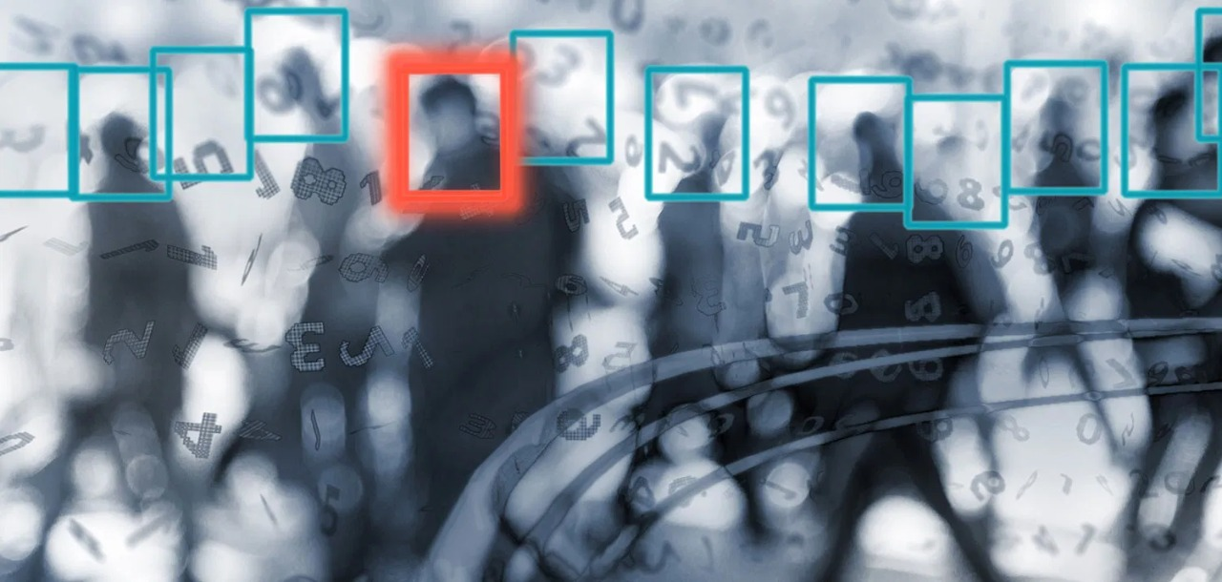
Error in Face Matching with available face data
One face Not matched among all others

Slide 27
Drone Antennas,
Downward Ultrasonic Obstacle Avoidance Senso,
Flight LED,
Main Camera Board
Working of Drones:
With a joystick and a GPS, most consumer drones' operations seem no more complicated than playing a video game. However, behind the easy user interface are an accelerometer, a gyroscope, and other complex technologies working to make drone flight mechanics as smooth as possible. Drones can be controlled remotely, often from a smartphone or tablet. Wireless connectivity lets pilots view the drone and its surroundings from a birds-eye perspective. Users can also leverage apps to pre-program specific GPS coordinates and create an automated drone flight path. Another handy wirelessly-enabled feature is the ability to track battery charge in real-time, an essential consideration since drones use smaller batteries to keep their weight low.
Rotors
A drone relies on rotors for its vertical motion. Drones use their rotors—which consist of a propeller attached to a motor—to hover, meaning the downward thrust of the drone is equal to the gravitational pull working against it; climb when pilots increase the speed until the rotors produce an upward force greater than gravity; and descend, when pilots perform the opposite and decrease rate.
To hover, two of a drone’s four rotors move clockwise, while the other two moves counter clockwise, ensuring that the drone's sideways momentum remains balanced. To avoid throwing its vertical motion off-kilter, the other two rotors on the drone will increase their spin. The same principle applies to moving forward and backward—the rotors of the drone must apply thrust while making sure the wheel of the rotors keeps the drone balanced.

Slide 28
Accelerometer and Altimeter
An accelerometer feeds the drone information about its speed and direction, while an altimeter tells the machine its altitude. These features also help a drone land slowly and safely, preventing it from sinking into an air vacuum called a wash that could pull the aircraft down in an unpredictable way.
Cameras
Some drones have built-in cameras on board that allow the pilot to see where the drone is flying without having a direct line of sight to the device. Drone-mounted cameras help users see difficult-to-reach locations and can be a game-changing tool for first responders, especially in search-and-rescue scenarios.
The intricate engineering that goes into building drones means that pilots don’t need to worry about balance, thrust, and other complexities and can enjoy the act of flying them. The machines' ultra-responsive nature, which will only be heightened with 5G, even allows experts to race drones through high-speed obstacle courses.
Drones are versatile pieces of equipment that harness wireless technology's power to do everything from taking video to assisting in emergencies. And their utility is only going to grow as the technology evolves and the world becomes more connected. You can learn more about the transformative potential of drones here.
More on Working of drone:
Unmanned aerial vehicle technology covers everything from the drone's aerodynamics, materials in the physical UAV manufacture to the circuit boards, chipset, and software, which are the drone's brains.
Material from which they are made - A typical uncrewed aircraft is made of light composite materials to reduce weight and increase manoeuvrability. This composite material strength allows military drones to cruise at too high altitudes( general material - Carbon fiber-reinforced composites (CRFCs) Thermoplastics such as polyester, nylon, polystyrene, etc. Aluminium). An unmanned aerial vehicle system has two parts, the drone itself and the control system.

Slide 29
GNSS satellites, High-end GNSS systems use Satellite Constellation technology. A satellite constellation is a group of satellites working together, giving coordinated coverage, and are synchronized to overlap well in range. Pass or coverage is the period in which a satellite is visible above the local horizon.
UAV Drone GNSS On Ground Station Remote Controller
The radar technology will signal the following on the remote controller display;
Signal that enough drone GNSS satellites have been detected and the drone is ready to fly.
Display the current position and location of the drone in relation to the pilot.
Record the home point for ‘Return To Home’ safety feature.
Most of the latest UAVs have 3 types of Return to Home drone technology as follows:
Pilot initiated return to home by pressing button on Remote Controller or in an app.
A low battery level, where the UAV will fly automatically back to the home point.
Loss of contact between the UAV and Remote Controller, with the UAV flying back automatically to its home point.
The latest Mavic Air 2 technology can sense obstacles during automatic return to home.
Obstacle Detection and Collision Avoidance Technology
The latest high-tech drones are now equipped with collision avoidance systems. These use obstacle detection sensors to scan the surroundings, while software algorithms and SLAM technology produce the images into 3D maps allowing the drone to sense and avoid. These systems fuse one or more of the following sensors to sense and avoid:
Vision Sensor
Ultrasonic
Infrared
Lidar
Time of Flight (ToF)

Slide 30
Monocular Vision
Gyroscope Stabilization, IMU And Flight Controllers
Gyro stabilization technology give the UAV drone its smooth flight capabilities.
The gyroscope works almost instantly to the forces moving against the drone, keeping it flying or hovering very smoothly. The gyroscope provides essential navigational information to the central flight controller.
The inertial measurement unit (IMU) works by detecting the current rate of acceleration using one or more accelerometers. The IMU detects changes in rotational attributes like pitch, roll and yaw using one or more gyroscopes. Some IMU include a magnetometer to assist with calibration against orientation drift.
The Gyroscope is a component of the IMU and the IMU is an essential component of the drone’s flight controller. The flight controller is the central brain of the drone.
UAV Drone Propulsion Technology
The propulsion system (motors, electronic speed controllers, and propellers) are the drone technology, which moves the UAV into the air and to fly in any direction or hover. On a quadcopter, the motors and propellers work in pairs with two motors/propellers rotating clockwise (CW Propellers) and two motors rotating Counter Clockwise (CCW Propellers).
They receive data from the flight controller and the electronic speed controllers (ESC) on the drone motor direction to either fly or hover.
Top UAV drone motors and propulsion systems are highly advanced and include the following components:
Motor Stator
Motor Bell (rotor)
Windings
Bearings
Cooling System

Slide 31
Electronic Speed Controllers
ESC Updater
Propellers
Wiring
Arm
The Electronic Speed Controllers signal to the drone motors information on speed, braking and also provide monitoring and fault tolerance on the drone motors.
Real-time Telemetry Flight Parameters
Nearly all drones have a Ground Station Controller (GSC) or a smartphone app, allowing you to fly the drone and track the current flight telemetry. Telemetry data showing on the remote controller includes UAV range, height, speed, GNSS strength, remaining battery power, and warnings.
Many UAV drone ground controllers use FPV (First Person View), which transmit the video from the drone to the controller or mobile device.
Information on what is drone technology and how does drone technology work in Quadcopters.
No Fly Zone Drone Technology
To increase flight safety and prevent accidents in restricted areas, the latest drones from DJI and other manufacturers include a “No Fly Zone” feature.
The no-fly zones are regulated and categorized by the Federal Aviation Authority (FAA). Manufacturers can change the no-fly zone drone technology using UAV firmware updates.

Slide 32
GPS Ready To Fly Mode Drone Technology
When the compass is calibrated, it then seeks the location of GPS satellites. When more than six are found, it allows the drone to fly in the “Ready To Fly” Mode.
Internal Compass & Failsafe Function
It Allows the UAV drone and remote-control system to know precisely its flight location. A home point can be set, and this is where the drone will return to if the drone and the remote-control system stop connecting. This is also known as the “fail-safe function.”
FPV Live Video Transmission Drone Technology
FPV means “First Person View.” A video camera is mounted on the uncrewed aerial vehicle, and this camera broadcasts the live video to the pilot on the ground. The ground pilot is flying the aircraft as if they were on-board the aircraft instead of looking at the plane from the pilot’s actual ground position.
FPV allows the uncrewed aircraft to fly much higher and further than you can from looking at the plane from the ground. First Person View allows for more precise flying, especially around obstacles.
Drones With Sensors To Create 3D Maps And Models Using Sensor Fusion
Lidar, Multispectral, and Photogrammetry sensors are being used to build 3D models of buildings and landscapes. Low light night vision and Thermal vision sensors are being used on drones to scan buildings and landscapes to assist in agriculture, firefighting, search, and rescue.
Drones can carry different sensors with the software combining the data for better results. This technology is known as sensor fusion and works as follows;
Sensor fusion is software that intelligently combines data from several sensors such as a thermal camera and a regular RGB camera sensor to improve application or system performance. Combining data from multiple sensors corrects the errors from individual sensors to calculate the accurate position and orientation information.

Slide 33
For example, multispectral sensors on drones can create Digital Elevation Maps (DEMS) of land areas to provide precision data on the health of crops, flowers, fauna, shrubs, and trees.
Drone Security And Hacking
UAV drones, in many ways, are like flying computers. With an operating system, flight controllers, and mainboards with programmable code, they can also be hacked into. Drones have been developed to fly around seeking other drones and to hack into the drone's wireless network, disconnecting the owner and take over that drone. However, there are some practical ways to protect your drone from hackers.
Drones For Tracking
One of the most exciting drone technologies is tracking subjects (people, vehicles, boats), particularly in outdoor sports such as running, cycling, skiing, etc. The latest drones with excellent tracking abilities are the Mavic 2, and the latest Skydio 2 where it’s tracking is so good that it never loses contact with the subject it is following.
These drones use their vision systems, detection sensors, GNSS systems, flight controllers, central processing, and specific software to track their subjects with 100 accuracies.

Slide 34
Code For Face Detection App

Slide 35
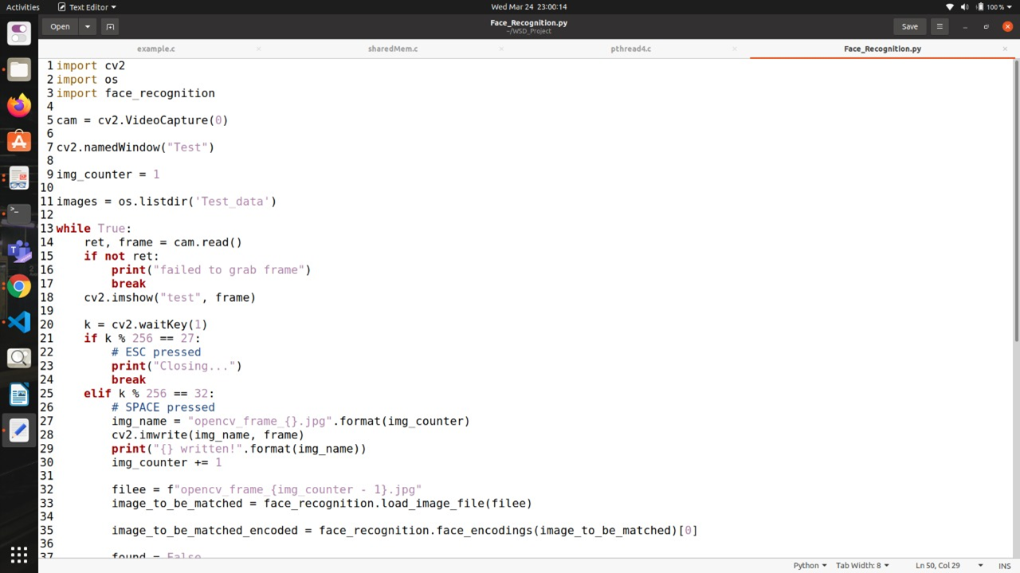

Slide 36
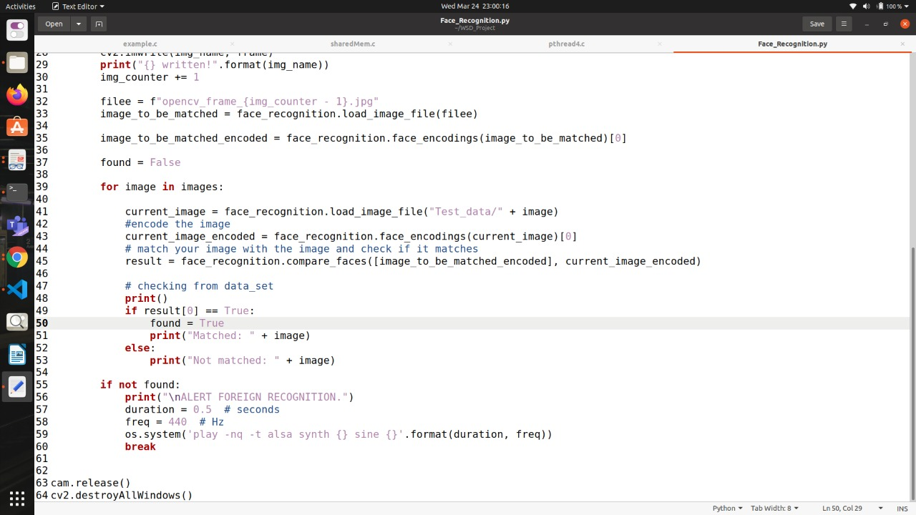

Slide 37
Limitation and Accuracy of code

Slide 38
Prerequisites for the Algorithm to work :: - The person should not have worn a mask or covered his face. Basically it’s like Face should be clearly Visible. - Also a Front Face vision must be there of the person whose image is to be captured and recognized
Accuracy :: We have tested the code for almost 100 pictures and in 68 of them we got the right results as it detected the face of the person and displayed the details about it. So , accuracy = 68% Error = 32%
First Drawback: Since this is done by only the front camera of the Device. In reality, a solution to this problem is that We should have High Quality and Resolution cameras at different angles around the fencing and the drone Areas to enhance this security System. Since Human detection using the sensors is also in use therefore this accuracy can be enhanced up to 75-80%.
Second Drawback :: In night/dark, this algorithm could not work effectively therefore a solution to that is we can use lighting near the prone Areas which is usually there so as to enhance the security and also make use of this algorithm. There can be some other drawbacks too if we make the process extremely complicated which are neglected here.

Slide 39
A Glimpse Of Our Face Detection Application

Slide 40

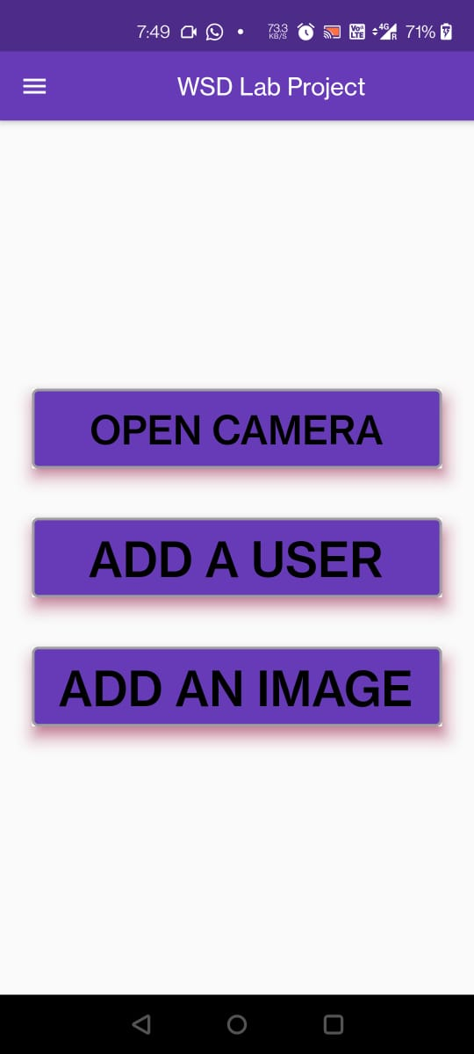
Interfaces of the Application

Slide 41
Results obtained showing Accuracy and Limitations by performing some Experiments

Slide 42
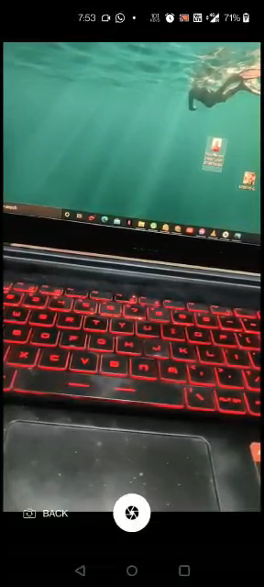
Experiment without any change in expression or hiding of face -
This is the normal situation where we find the person is either terrorist or Indian Soldier.

Slide 43
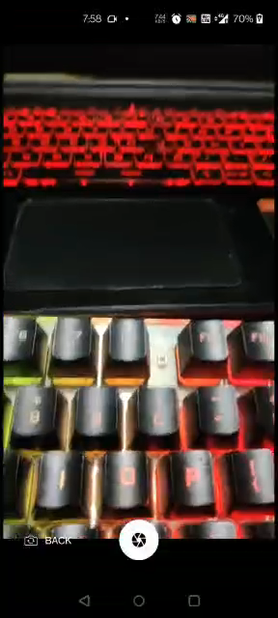
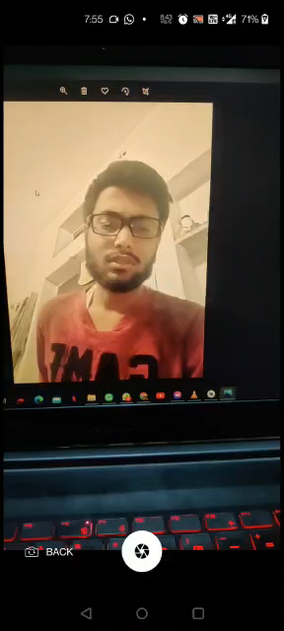
Experiment for the change in expression -
As it is working for all expressions possible this is very helpful in detection because, it is obvious that usually same expression can not be made by Indian Soldiers as made in the image uploaded in our Indian database.

Slide 44
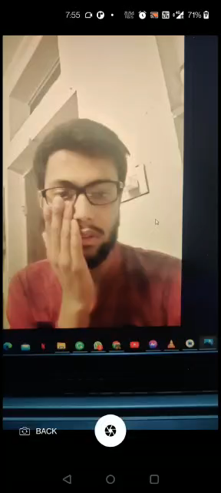

Experiment for hiding of the face -
This situation can occur if the person in front of the Drone is Terrorist whose face is hidden by cloth and can even occur if the person is Indian Soldier with his face Damaged.

Slide 45
Thank you

